Slide 1
Basic Concepts
Computer Organization and Assembly Language
Ms. Tayyaba Zaheer
Computer Science Department
CUST, Islamabad

Slide 2
Data Representation
Binary Numbers
Decimal Numbers
Hexadecimal Numbers
Octal Number System
Base Conversions
Integer Storage Sizes
Binary and Hexadecimal Addition
Signed Integers and 2's Complement Notation
Binary and Hexadecimal subtraction
Carry and Overflow
Character Storage

Slide 3
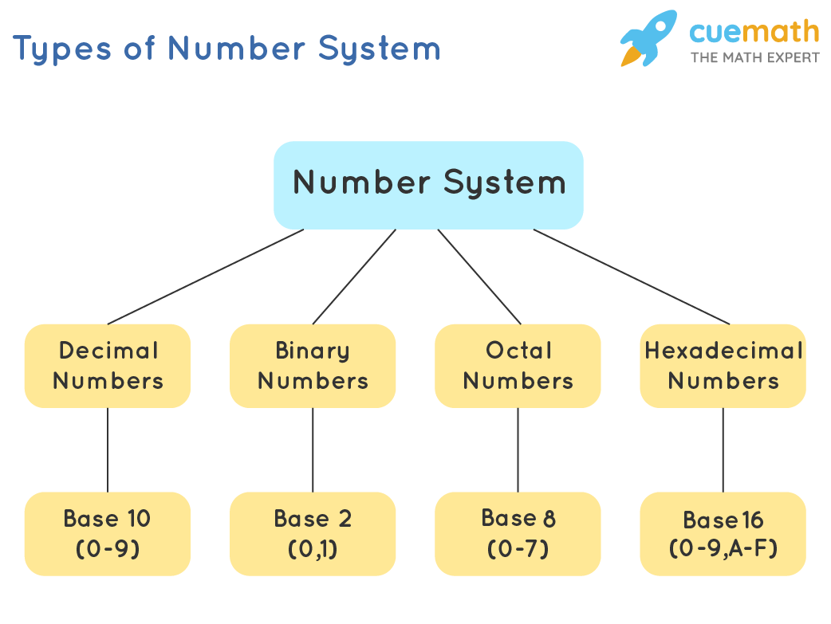
Number Bases
Binary: Base 2
(0, 1)
Octal: Base 8
(0, 1, 2, 3, 4, 5, 6, 7)
Decimal: Base 10
(0, 1, 2, 3, 4, 5, 6, 7, 8, 9)
Hexadecimal: Base 16
(0, 1, 2, 3, 4, 5, 6, 7, 8, 9, A, B, C, D, E, F)

Slide 4
Binary Numbers
Computers store and process data in terms of binary numbers.
Binary numbers consist of only the digits 1 and 0.
It is important for Computer Scientists and Computer Engineers to understand how binary numbers work.
Note: “Binary Numbers” are also referred to as “Base 2” numbers.

Slide 5
Review of Placeholders
You probably learned about placeholders in the 2nd or 3rd grade. For example:
1000’s place
100’s place
10’s place
1’s place
3125
So this number represents
3 thousands
1 hundred
2 tens
5 ones
Mathematically, this is
(3 x 1000) + (1 x 100) + (2 x 10) + (5 x 1)
= 3000 + 100 + 20 + 5 = 3125
But why are the placeholders 1, 10, 100, 1000, and so on?

Slide 6
More on Placeholders
The numbers commonly used by most people are in Base 10.
The Base of a number determines the values of its placeholders.
10³ place
10² place
10¹ place
10⁰ place
3125₁₀
To avoid ambiguity, we often write the base of a number as a subscript.

Slide 7
Binary Numbers - Example
8’s place
4’s place
2’s place
1’s place
2³ place
2² place
2¹ place
2⁰ place
1010₂
This subscript denotes that this number is in Base 2 or “Binary”.

Slide 8
Binary Numbers - Example
8’s place
4’s place
2’s place
1’s place
1010₂
So this number represents
1 eight
0 fours
1 two
0 ones
Mathematically, this is
(1 x 8) + (0 x 4) + (1 x 2) + (0 x 1)
= 8 + 0 + 2 + 0 = 10₁₀

Slide 9
Which Digits Are Available in which Bases
Base 10
0
1
2
3
4
5
6
7
8
9
10
Base 2
0
1
10
Base 16
0
1
2
3
4
5
6
7
8
9
A
B
C
D
E
F
10
2 digits
Base 16
Cheat Sheet
A₁₆ = 10₁₀
B₁₆ = 11₁₀
C₁₆ = 12₁₀
D₁₆ = 13₁₀
E₁₆ = 14₁₀
F₁₆ = 15₁₀
Add Placeholder
10 digits
16 digits
Add Placeholder
Note: Base 16 is also called “Hexadecimal” or “Hex”.
Add Placeholder

Slide 10
Hexadecimal Numbers - Example
256’s place
16’s place
1’s place
16² place
16¹ place
16⁰ place
3AB₁₆
Note:
16² = 256
This subscript denotes that this number is in Base 16 or “Hexadecimal” or “Hex”.

Slide 11
Hexadecimal Numbers - Example
256’s place
16’s place
1’s place
Base 16
Cheat Sheet
A₁₆ = 10₁₀
B₁₆ = 11₁₀
C₁₆ = 12₁₀
D₁₆ = 13₁₀
E₁₆ = 14₁₀
F₁₆ = 15₁₀
3AB₁₆
So this number represents
3 two-hundred fifty-sixes
10 sixteens
11 ones
Mathematically, this is
(3 x 256) + (10 x 16) + (11 x 1)
= 768 + 160 + 11 = 939₁₀

Slide 12
Why Hexadecimal Is Important
What is the largest number you can represent using four binary digits?
What is the largest number you can represent using a single hexadecimal digit?
Base 16
Cheat Sheet
A₁₆ = 10₁₀
B₁₆ = 11₁₀
C₁₆ = 12₁₀
D₁₆ = 13₁₀
E₁₆ = 14₁₀
F₁₆ = 15₁₀
_ _ _ _
1
1
1
1
_
2³
2²
2¹
2⁰
2
F
= 15₁₀
=
=
=
=
16
8
4
2
1
… the smallest number?
8 + 4 + 2 + 1 = 15₁₀
_
0
= 0₁₀
Note: You can represent the same range of values with a single hexadecimal digit that you can represent using four binary digits!
… the smallest number?
_ _ _ _
16
0
0
0
0
2³
2²
2¹
2⁰
2
0 + 0 + 0 + 0 = 0₁₀

Slide 13
Why Hexadecimal Is Important Continued
It can take a lot of digits to represent numbers in binary.
Hexadecimal numbers can be used to abbreviate binary numbers.
Example:
51794₁₀ = 1100101001010010₂
Starting at the least significant digit, split your binary number into groups of four digits.
Long strings of digits can be difficult to work with or look at.
Also, being only 1’s and 0’s, it becomes easy to insert or delete a digit when copying by hand.
Convert each group of four binary digits to a single hex digit.

Slide 14
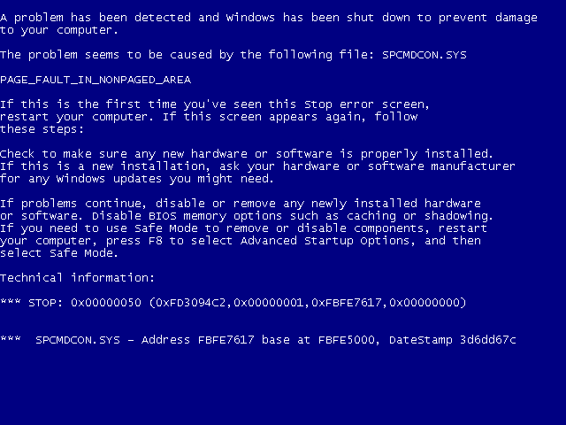
Windows “Blue Screen of Death”
In many situations, instead of using a subscript to denote that a number is in hexadecimal, a “0x” is appended to the front of the number.
Look! Hexadecimal Numbers!

Slide 15
Binary Numbers
Digits are 1 and 0
1 = true
0 = false
MSB – most significant bit
LSB – least significant bit
Bit numbering:

Slide 16
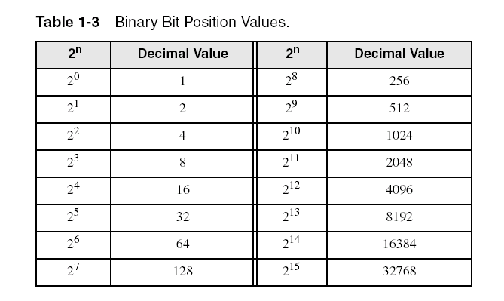
Binary Numbers
Each digit (bit) is either 1 or 0
Each bit represents a power of 2:
Every binary number is a sum of powers of 2

Slide 17
Converting Decimal to Binary
Example:
We want to convert 125₁₀ to binary.
125 / 2 = 62 R 1
62 / 2 = 31 R 0
31 / 2 = 15 R 1
15 / 2 = 7 R 1
7 / 2 = 3 R 1
3 / 2 = 1 R 1
1 / 2 = 0 R 1
125₁₀ = 1111101₂

Slide 18
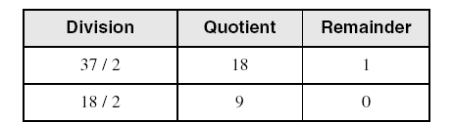
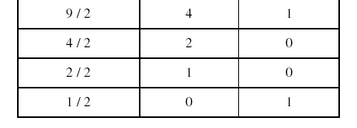
Convert Decimal to Binary
Repeatedly divide the decimal integer by 2. Each remainder is a binary digit in the translated value:
least significant bit
most significant bit
37 = 100101
stop when quotient is zero

Slide 19
Converting Binary to Decimal
Weighted positional notation shows how to calculate the decimal value of each binary bit:
Decimal = (d_{n-1} × 2^{n-1}) + (d_{n-2} × 2^{n-2}) + ... + (d₁ × 2¹) + (d₀ × 2⁰)
d = binary digit
binary 00001001 = decimal 9:
(1 × 2³) + (1 × 2⁰) = 9

Slide 20
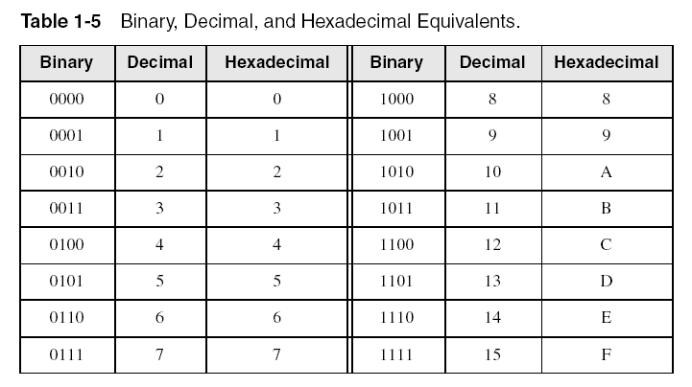
Hexadecimal Integers
Binary values are represented in hexadecimal.

Slide 21
Converting Binary Numbers to Hex
Recall the example binary number from the previous slide:
1100101001010010₂
Base 16
Cheat Sheet
A₁₆ = 10₁₀
B₁₆ = 11₁₀
C₁₆ = 12₁₀
D₁₆ = 13₁₀
E₁₆ = 14₁₀
F₁₆ = 15₁₀
1100 1010 0101 0010₂
C
A
5
2
₁₆
First, split the binary number into groups of four digits, starting with the least significant digit.
Next, convert each group of four binary digits to a single hex digit.
Put the single hex digits together in the order in which they were found, and you’re done!

Slide 22

Converting Binary to Hexadecimal
Each hexadecimal digit corresponds to 4 binary bits.
Example: Translate the binary integer 000101101010011110010100 to hexadecimal:

Slide 23
Converting Hexadecimal to Binary
How to convert from hexadecimal number to binary number.
How to convert base 16 to base 2.
Convert each hex digit to 4 binary digits according to this table:

Slide 24
Converting Hexadecimal to Binary
Hex | Binary
0 | 0000
1 | 0001
2 | 0010
3 | 0011
4 | 0100
5 | 0101
6 | 0110
7 | 0111
8 | 1000
9 | 1001
A | 1010
B | 1011
C | 1100
D | 1101
E | 1110
F | 1111

Slide 25
Converting Hexadecimal to Binary
Example #1
Convert (4E)₁₆ to binary:
(4)₁₆ = (0100)₂
(E)₁₆ = (1110)₂
_{So}
(4E)₁₆ = (01001110)₂
Example #2
Convert (4A01)₁₆ to binary:
(4)₁₆ = (0100)₂
(A)₁₆ = (1010)₂
(0)₁₆ = (0000)₂
(1)₁₆ = (0001)₂
_{So}
(4A01)₁₆ = (0100101000000001)₂

Slide 26
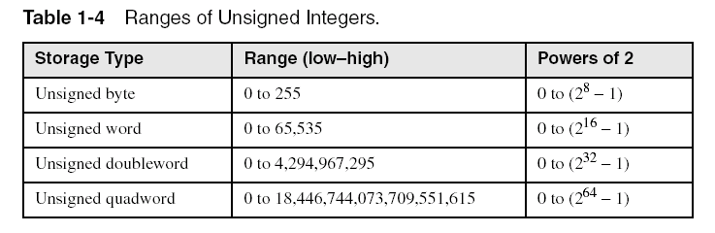
Integer Storage Sizes
Standard sizes:
What is the largest unsigned integer that may be stored in 20 bits?
2²⁰ - 1 = 1048575

Slide 27
Binary Addition
Start with the least significant bit (rightmost bit)
Add each pair of bits
Include the carry in the addition, if present
carry:
1
0
0
0
0
0
1
0
0
(4)
+
0
0
0
0
0
1
1
1
(7)
0
0
0
0
1
0
1
1
(11)
bit position:
7
6
5
4
3
2
1
0

Slide 28
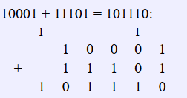
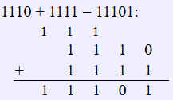
Binary Addition-Tasks
10001 + 11101
1110 + 1111
Solution:
Solution:

Slide 29
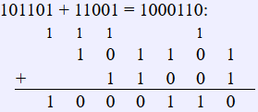
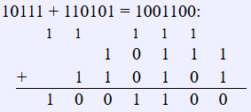
Binary Addition-Tasks
101101 + 11001
10111 + 110101
Solution:
Solution:

Slide 30
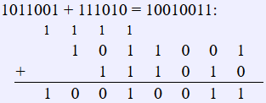
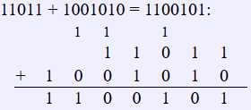
Binary Addition-Tasks
1011001 + 111010
11011 + 1001010
Solution:
Solution:

Slide 31
Hexadecimal Addition
Divide the sum of two digits by the number base (16). The quotient becomes the carry value, and the remainder is the sum digit.
1
1
36 28 28 6A
42 45 58 4B
78 6D 80 B5
21 / 16 = 1, remainder 5
Important skill: Programmers frequently add and subtract the addresses of variables and instructions.

Slide 32

Hexadecimal Addition-Tasks
182AB + 5FCAA

Slide 33
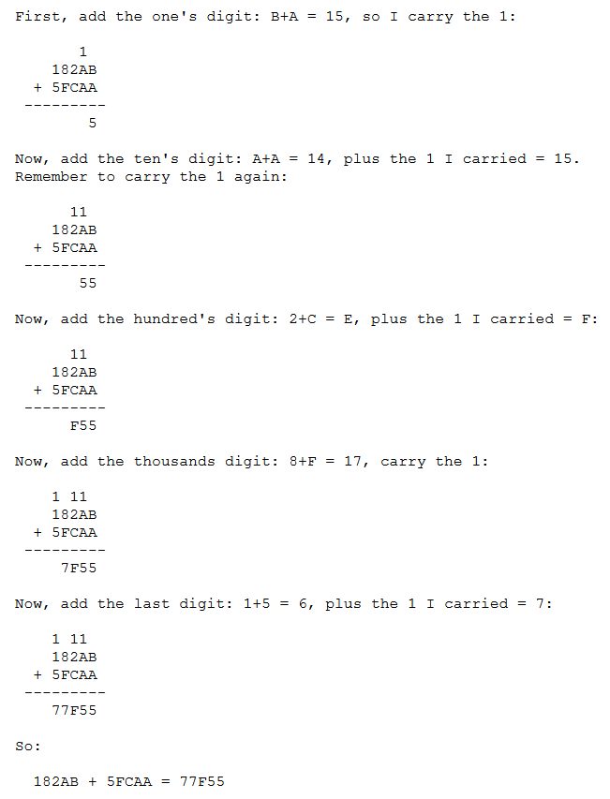

Slide 34
Signed Integers
Several ways to represent a signed number
Sign-Magnitude
Biased
1's complement
2's complement
Divide the range of values into 2 equal parts
First part corresponds to the positive numbers (≥ 0)
Second part correspond to the negative numbers (< 0)
Focus will be on the 2's complement representation
Has many advantages over other representations
Used widely in processors to represent signed integers

Slide 35
Representation of negative numbers
Is a representation of negative numbers possible?
Unfortunately:
you can not just stick a negative sign in front of a binary number. (it does not work like that)
There are three methods used to represent negative numbers.
Signed magnitude notation
Excess notation notation
Two’s complement notation

Slide 36
Signed Magnitude Representation
Unsigned: - and + are the same.
In signed magnitude
the left-most bit represents the sign of the integer.
0 for positive numbers.
1 for negative numbers.
The remaining bits represent to magnitude of the numbers.

Slide 37
Example
Suppose 10011101 is a signed magnitude representation.
The sign bit is 1, then the number represented is negative
The magnitude is 0011101 with a value 2⁴+2³+2²+2⁰= 29
Then the number represented by 10011101 is –29.
position | 7 | 6 | 5 | 4 | 3 | 2 | 1 | 0
Bit pattern | 1 | 0 | 0 | 1 | 1 | 1 | 0 | 1
contribution | - |  |  | 2⁴ | 2³ | 2² |  | 2⁰

Slide 38
Exercise 1
37₁₀ has 0010 0101 in signed magnitude notation. Find the signed magnitude of –37₁₀ ?
1010 0101
Using the signed magnitude notation find the 8-bit binary representation of the decimal value 24₁₀ and -24₁₀.
24₁₀=00011000, -24₁₀=10011000
Find the signed magnitude of –63 using 8-bit binary sequence?
-63=10111111

Slide 39
Disadvantage of Signed Magnitude
Addition and subtractions are difficult.
Signs and magnitude, both have to carry out the required operation.
They are two representations of 0
00000000 = + 0₁₀
10000000 = - 0₁₀
To test if a number is 0 or not, the CPU will need to see whether it is 00000000 or 10000000.
0 is always performed in programs.
Therefore, having two representations of 0 is inconvenient.

Slide 40
Signed-Summary
In signed magnitude notation,
The most significant bit is used to represent the sign.
1 represents negative numbers
0 represents positive numbers.
The unsigned value of the remaining bits represent The magnitude.
Advantages:
Represents positive and negative numbers
Disadvantages:
two representations of zero,
Arithmetic operations are difficult.

Slide 41
Two's Complement Representation
Positive numbers
Signed value = Unsigned value
Negative numbers
UnSigned value = Signed value + 2^{n}
n = number of bits
Negative weight for MSB
Another way to obtain the signed value is to assign a negative weight to most-significant bit
= -128 + 32 + 16 + 4 = -76
8-bit Binary value | Unsigned value | Signed value
00000000 | 0 | 0
00000001 | 1 | +1
00000010 | 2 | +2
. . . | . . . | . . .
01111110 | 126 | +126
01111111 | 127 | +127
10000000 | 128 | -128
10000001 | 129 | -127
. . . | . . . | . . .
11111110 | 254 | -2
11111111 | 255 | -1
1
0
1
1
0
1
0
0
-128
64
32
16
8
4
2
1
Notes:
Another Way::
Signed Value→-1
2^{n}-(1)=256-1=255=Binary(11111111)

Slide 42
Forming the Two's Complement
starting value | 00100100 = +36
step1: reverse the bits (1's complement) | 11011011
step 2: add 1 to the value from step 1 | + 1
sum = 2's complement representation | 11011100 = -36
Sum of an integer and its 2's complement must be zero:
00100100 + 11011100 = 00000000 (8-bit sum) ⇒ Ignore Carry
The easiest way to obtain the 2's complement of a binary number is by starting at the LSB, leaving all the 0s unchanged, look for the first occurrence of a 1. Leave this 1 unchanged and complement all the bits after it.

Slide 43
Two’s Complement
+3 = 00000011
+2 = 00000010
+1 = 00000001
+0 = 00000000
-1 = 11111111
-2 = 11111110
-3 = 11111101

Slide 44
Benefits
One representation of zero
Arithmetic works easily (see later)
Negating is fairly easy
3 = 00000011
Boolean complement gives 11111100
Add 1 to LSB 11111101

Slide 45
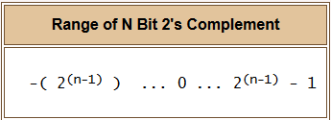
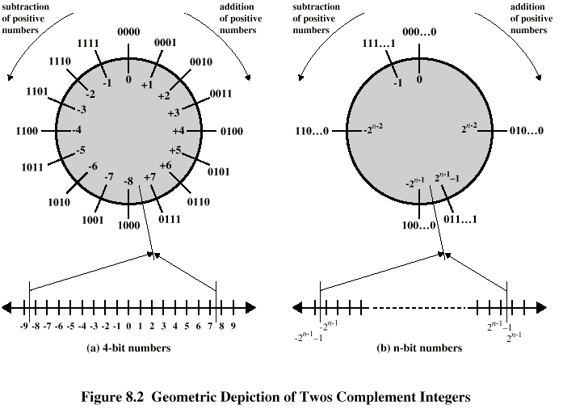
Forming the Two's Complement

Slide 46
IEEE 754
Standard for floating point storage
32 and 64 bit standards
8 and 11 bit exponent respectively
Extended formats (both mantissa and exponent) for intermediate results

Slide 47
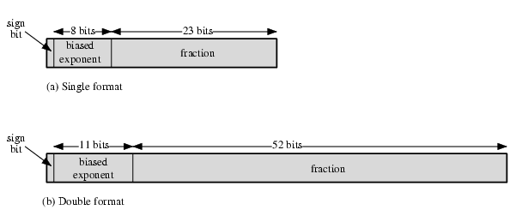
IEEE 754 Formats

Slide 48
Convert Float to Floating Point Representation – 32 Bit
Float a = 5.2
Binary of 5 = 101
Binary of Fractional part i.e. “.2” would be:
.2^{*2} 0
.4 0
.8 1
.6 1
.2
.2*2=0.4; .4*2=0.8; .8*2=1.6; 0.6*2=1.2; .2=.2
5.2=101.00110011

Slide 49
Convert Float to Floating Point Representation – 32 Bit
5.2=101.00110011 (Move the fractional point or dot just before the first one)
1.0100110011… E+2
Bias 127; so, 127+2 = 129 = 10000001
0
1
0
0
0
0
0
0
1
0
1
0
0
1
1
0
0
1
1
0
0
1
1
…
1 Bit
Sign
5.2 is
Positive#
8 Bits
Exponent
23 Bits
Mantissa

Slide 50
Convert Float to Floating Point Representation – 32 Bit
Float a = 5.2
In Binary
01000000101001100110011001100110
In Hexadecimal
40A66666

Slide 51
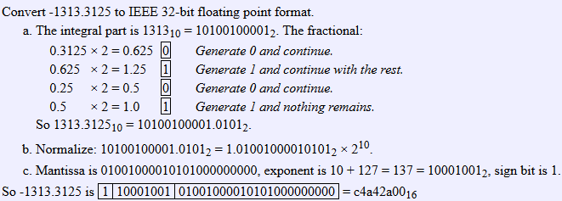
Convert Float to Floating Point Representation – 32 Bit

Slide 52
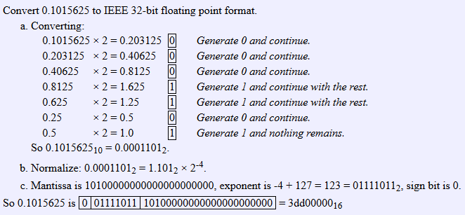
Convert Float to Floating Point Representation – 32 Bit

Slide 53
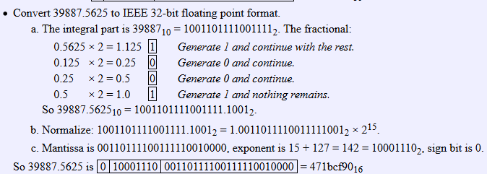
Convert Float to Floating Point Representation – 32 Bit

Slide 54
Convert Float to Floating Point Representation – 8 Bit
Float a = 11.8
Binary of 11 = 1011
Binary of Fractional part i.e. “.8” would be:
.8^{*2} 1
.6 1
.2 0
.4 0
.8
.8*2=1.6; .6*2=1.2; .2*2=0.4; 0.4*2=0.8; .8=.8
11.8=1011.110011001100...

Slide 55
Convert Float to Floating Point Representation – 8 Bit
(11.8)₁₀=(1011.110011001100...)₂ (Move the fractional point or dot just before the first one)
(1.011110011001100...)₂ *2³
(1.0111)₂ *2³ (4 bit mantissa) = (1.0111)₂ *2⁽¹¹⁾₂
(1.0111)₂ *2⁽⁰¹¹⁾₂= (3 bit exponent)
Bias 3; so, 3+3 = 6 = 110
0
1
1
0
0
1
1
1
+(1.0111)₂*2⁽¹¹⁰⁾₂
1 Bit
Sign
is
Positive#
3 Bits
Exponent
4 Bits
Mantissa

Slide 56
Convert Float to Floating Point Representation – 8 Bit
Float a = 3.15
Binary of 3 = 11
Binary of Fractional part i.e. “.15” is =
0.00100110011
.15^{*2} 0
.3 0
.6 1
.2 0
.4 0
.8 1
.6 1
.2 0
.4 0
.8 1
.6 1
.2

Slide 57
Convert Float to Floating Point Representation – 8 Bit
(3.15)₁₀=(11.00100110011...)₂ (Move the fractional point or dot just before the first one)
(1.100100110011...)₂ *2¹
(1.1001)₂ *2¹ (4 bit mantissa) = (1.1001)₂ *2⁽¹⁾₂
(1.1001)₂ *2⁽⁰⁰¹⁾₂= (3 bit exponent)
Bias 3; so, 3+1 = 4 = 100
0
1
0
0
1
0
0
1
+(1.1001)₂*2⁽¹⁰⁰⁾₂
1 Bit
Sign
is
Positive#
3 Bits
Exponent
4 Bits
Mantissa

Slide 58
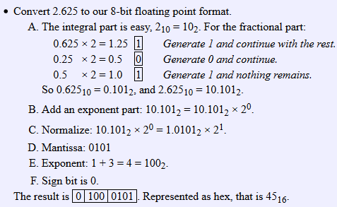
Convert Float to Floating Point Representation – 8 Bit

Slide 59
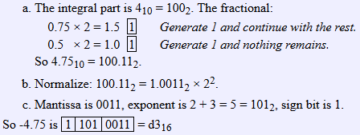
Convert Float to Floating Point Representation – 8 Bit

Slide 60
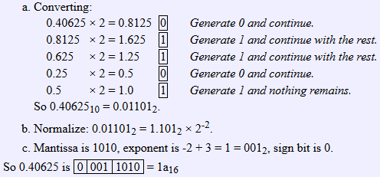
Convert Float to Floating Point Representation – 8 Bit

Slide 61
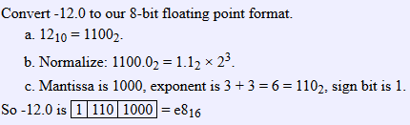
Convert Float to Floating Point Representation – 8 Bit

Slide 62
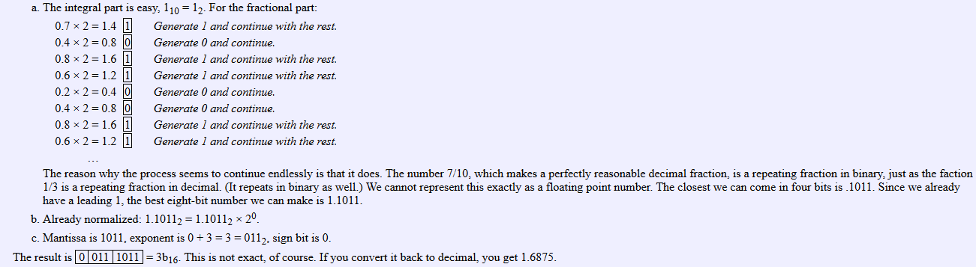
Convert Float to Floating Point Representation – 8 Bit

Slide 63
Convert Float to Floating Point Representation – 8 Bit
Float a = -.05
Binary of 0 = 0
Binary of Fractional part i.e. “.05” is =
0000110011
.05^{*2} 0
.1 0
.2 0
.4 0
.8 1
.6 1
.2 0
.4 0
.8 1
.6 1
.2

Slide 64
Convert Float to Floating Point Representation – 8 Bit
(0.05)₁₀=(0.0000110011...)₂ (Move the fractional point or dot just after the first one)
(00001.10011...)₂ *2⁻⁵
(1.1001)₂ *2⁻⁵ (4 bit mantissa)
Bias 3; so, -5+3 = -2 = 010
1 Bit
Sign of Exponent
1
1
0
1
0
1
0
0
1
-(1.1001)₂*2⁽⁻⁰¹⁰⁾₂
1 Bit
Sign
is
Negative#
3 Bits
Exponent
4 Bits
Mantissa

Slide 65
Convert Float to Floating Point Representation – 8 Bit
Float a = 20.38
Binary of 20 = 10100
Binary of Fractional part i.e. “.38” is =
01100001010…
.38^{*2} 0
.76 1
.52 1
.04 0
.08 0
.16 0
.32 0
.64 1
.28 0
.56 1
.12 0
.24

Slide 66
Convert Float to Floating Point Representation – 8 Bit
(20.38)₁₀=(10100. 01100001010...)₂ (Move the fractional point or dot just before the first one)
(1.010001100001010...)₂ *2⁴
(1.0100)₂ *2⁴ (4 bit mantissa)
Bias 3; so, 3+4 = 7 = 111
0
1
1
1
0
1
0
0
+(1.0100)₂*2⁽¹¹¹⁾₂
1 Bit
Sign
is
Positive#
3 Bits
Exponent
4 Bits
Mantissa

Slide 67
Convert Float to Floating Point Representation – 8 Bit
Float a = -7.5
Binary of 7 = 111
Binary of Fractional part i.e. “.5” is =
100000000…
.5^{*2} 1

Slide 68
Convert Float to Floating Point Representation – 8 Bit
(-7.5)₁₀=(111. 10000...)₂ (Move the fractional point or dot just before the first one)
(1.1110000...)₂ *2²
(1.1110)₂ *2² (4 bit mantissa)
Bias 3; so, 3+2 = 5 = 101
1
1
0
1
1
1
1
0
-(1.1110)₂*2⁽¹⁰¹⁾₂
1 Bit
Sign
is
Negative#
3 Bits
Exponent
4 Bits
Mantissa

Slide 69
Sign Bit
Highest bit indicates the sign. 1 = negative, 0 = positive
If highest digit of a hexadecimal is > 7, the value is negative
Examples: 8A and C5 are negative bytes
A21F and 9D03 are negative words
B1C42A00 is a negative double-word

Slide 70
Sign Extension
Step 1: Move the number into the lower-significant bits
Step 2: Fill all the remaining higher bits with the sign bit
This will ensure that both magnitude and sign are correct
Examples
Sign-Extend 10110011 to 16 bits
Sign-Extend 01100010 to 16 bits
Infinite 0s can be added to the left of a positive number
Infinite 1s can be added to the left of a negative number
10110011 = -77
11111111 10110011 = -77
01100010 = +98
00000000 01100010 = +98

Slide 71
Two's Complement of a Hexadecimal
To form the two's complement of a hexadecimal
Subtract each hexadecimal digit from 15
Add 1
Examples:
2's complement of 6A3D = 95C2 + 1 = 95C3
2's complement of 92F0 = 6D0F + 1 = 6D10
2's complement of FFFF = 0000 + 1 = 0001
No need to convert hexadecimal to binary

Slide 72
Binary Subtraction
When subtracting A – B, convert B to its 2's complement
Add A to (–B)
0 0 0 0 1 1 0 0 0 0 0 0 1 1 0 0
0 0 0 0 0 0 1 0 1 1 1 1 1 1 1 0 (2's complement)
0 0 0 0 1 0 1 0 (same result)
Carry is ignored, because
Negative number is sign-extended with 1's
You can imagine infinite 1's to the left of a negative number
Adding the carry to the extended 1's produces extended zeros
–
+
Practice: Subtract 00100101 from 01101001.
Solution: 01000100
Notes:
01000100

Slide 73
Hexadecimal Subtraction
When a borrow is required from the digit to the left, add 16 (decimal) to the current digit's value
Last Carry is ignored
16 + 5 = 21
-1
1
1
C675
A247
242E
C675
5DB9 (2's complement)
242E (same result)
-
+
Practice: The address of var1 is 00400B20. The address of the next variable after var1 is 0040A06C. How many bytes are used by var1?
Solution: 0000954c
Notes:
981C Bytes

Slide 74
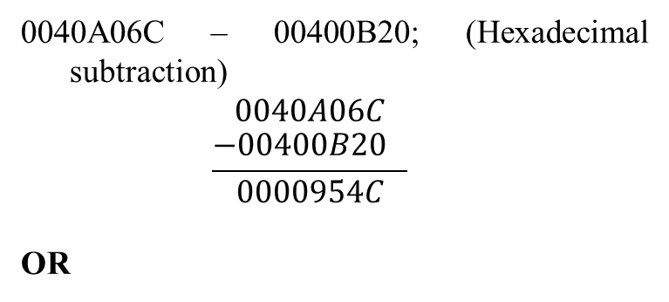
Hexadecimal Subtraction
Practice: The address of var1 is 00400B20. The address of the next variable after var1 is 0040A06C. How many bytes are used by var1?
Notes:
981C Bytes

Slide 75
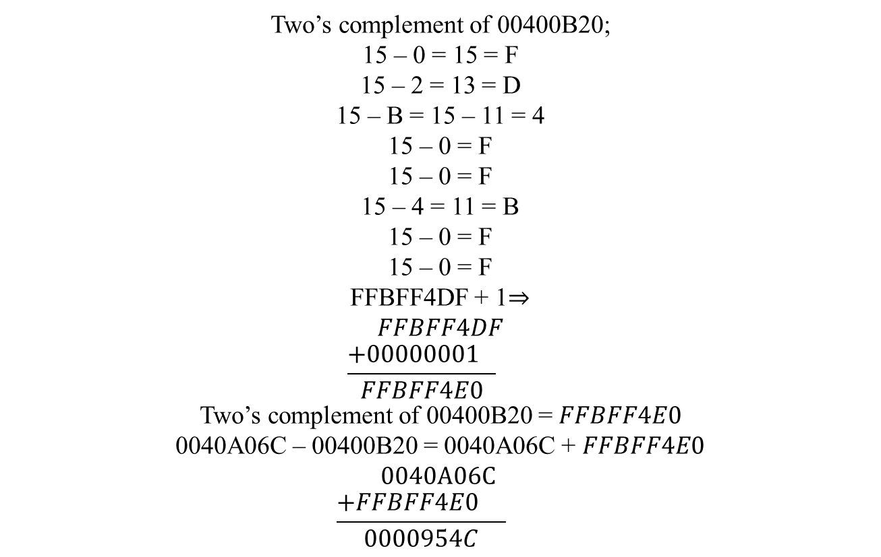
Hexadecimal Subtraction
Notes:
981C Bytes

Slide 76
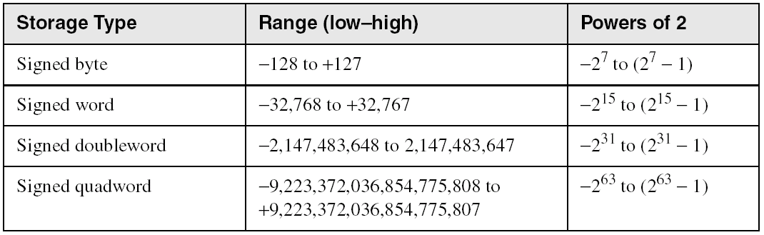
Ranges of Signed Integers
The unsigned range is divided into two signed ranges for positive and negative numbers
Practice: What is the range of signed values that may be stored in 20 bits?
Range (low-high): -524288 to +524287
Power of 2: -2¹⁹ to (2¹⁹ – 1)

Slide 77
Carry and Overflow
Carry is important when …
Adding or subtracting unsigned integers
Indicates that the unsigned sum is out of range
Either < 0 or >maximum unsigned n-bit value
Overflow is important when …
Adding or subtracting signed integers
Indicates that the signed sum is out of range
Overflow occurs when
Adding two positive numbers and the sum is negative
Adding two negative numbers and the sum is positive
Can happen because of the fixed number of sum bits

Slide 78
Carry and Overflow Examples
We can have carry without overflow and vice-versa
Four cases are possible
1
1
1
1
1
1
0
0
0
0
1
1
1
1
15
0
0
0
0
1
1
1
1
15
+
+
0
0
0
0
1
0
0
0
8
1
1
1
1
1
0
0
0
245 (-8)
0
0
0
1
0
1
1
1
23
0
0
0
0
0
1
1
1
7
Carry = 0 Overflow = 0
Carry = 1 Overflow = 0
1
1
1
1
0
1
0
0
1
1
1
1
79
1
1
0
1
1
0
1
0
218 (-38)
+
+
0
1
0
0
0
0
0
0
64
1
0
0
1
1
1
0
1
157 (-99)
1
0
0
0
1
1
1
1
143
(-113)
0
1
1
1
0
1
1
1
375
(-137)
Carry = 0 Overflow = 1
Carry = 1 Overflow = 1
Notes:
Perhaps the most elegant solution is to check for the sign of the sum and compare it against the signs of the numbers added.

Slide 79
Character Storage
Character sets
Standard ASCII: 7-bit character codes (0 – 127)
Extended ASCII: 8-bit character codes (0 – 255)
Unicode: 16-bit character codes (0 – 65,535)
Unicode standard represents a universal character set
Defines codes for characters used in all major languages
Used in Windows-XP: each character is encoded as 16 bits
UTF-8: variable-length encoding used in HTML
Encodes all Unicode characters
Uses 1 byte for ASCII, but multiple bytes for other characters
Null-terminated String
Array of characters followed by a NULL character
Notes:
UTF-8->8-bit Unicode Transformation Format

Slide 80
Printable ASCII Codes
 | 0 | 1 | 2 | 3 | 4 | 5 | 6 | 7 | 8 | 9 | A | B | C | D | E | F
2 | space | ! | " | # | $ | % | & | ' | ( | ) | * | + | , | - | . | /
3 | 0 | 1 | 2 | 3 | 4 | 5 | 6 | 7 | 8 | 9 | : | ; | < | = | > | ?
4 | @ | A | B | C | D | E | F | G | H | I | J | K | L | M | N | O
5 | P | Q | R | S | T | U | V | W | X | Y | Z | [ | \ | ] | ^ | _
6 | ` | a | b | c | d | e | f | g | h | i | j | k | l | m | n | o
7 | p | q | r | s | t | u | v | w | x | y | z | { | | | } | ~ | DEL
Examples:
ASCII code for space character = 20 (hex) = 32 (decimal)
ASCII code for 'L' = 4C (hex) = 76 (decimal)
ASCII code for 'a' = 61 (hex) = 97 (decimal)

